Slide 1
Artificial Intelligence for Omics Data Analysis
Ferrara Luigina
Gargiulo Anna
0622900144
0622900139

Slide 2
Project Description
The main tasks of the project are:
Examine gene expression data for tumour classification.
Select most relevant genes for single tumor and for all the five different tumors.
Compare performance with the state of the art.
The aim is to analyze the available dataset to perform tumor classification by using supervised and unsupervised methods.
Notes:
Riepilogare i task del progetto

Slide 3
Dataset
This collection of data is part of the RNA-Seq (HiSeq) PANCAN dataset, it is a random extraction of gene expressions of patients having different types of tumor: BRCA, KIRC, COAD, LUAD and PRAD.
The dataset is composed of 801 samples (stored row-wise) with 20531 features which are RNA-Seq gene expression levels measured.
Notes:
Il dataset disponibile è parte del RNA-Seq PANCAN dataset che contiene un’estrazione random delle espressioni geniche di patienti aventi 5 differenti tipi di tumori. Il dataset è composta da 801 campioni (row-wise) con 20531 features che sono i livelli di espressione genica misurati
The dataset is unbalanced in particular the BRCA class is the most representative while the COAD one is the less representative
BRCA — Breast invasive carcinoma, KIRC — Kidney renal clear cell carcinoma, COAD — Colon adenocarcinoma, LUAD — Lung adenocarcinoma and PRAD — Prostate adenocarcinoma.

Slide 4
Dataset Inspection & Preparation
01

Slide 5



Data Pre-Processing (Supervised approach)
1
5
Variance Threshold
Check for “Not Available” or “Null” values
2
4
Remove Correlated Features
Remove Outliers
3
Scaling
Notes:
It depends on what you exactly need for your use-case, but if you remove outliers after standardizing, the resulting data won't be standardized anymore

Slide 6
Removing Outliers
Outliers were identified using the Local Outlier Factor (LOF), an unsupervised Outlier Detection method.
The number of neighbours, n_neighbours = 15
Metric to use for distance computation = default, and Parameter for the Minkowski metric from, p = 2, to use the Euclidean distance for the computation;
Algorithm used to compute the nearest neighbors: auto, will attempt to decide the most appropriate algorithm based on the values passed to fit method
The amount of contamination of the data set, i.e., the proportion of outliers in the data set. When fitting this is used to define the threshold on the scores of the samples: auto
Notes:
Gli outliers sono identificati usando il Local Oulier Factor, un approccio non supervisionato di Outlier Detection.
L’algoritmo calcola il Local Outlier Factor di ogni campione che misura la deviazione locale della densità di un campione rispetto ai suoi vicini. Si parla di uno local factor in quanto dipende da quando l’oggetto è isolato rispetto al suo vicinato. It uses Euclidean distance to estimate the local density
By comparing the local density of a sample to the local densities of its neighbors, one can identify samples that have a substantially lower density than their neighbors. Questi sono gli outliers.
Abbiamo scelto di usare il valore standard per il numero di vicini

Slide 7
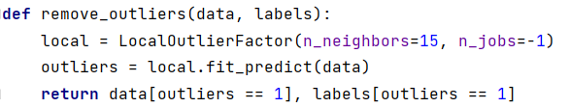
Removing Outliers
Outliers were identified using the Local Outlier Factor (LOF), an unsupervised Outlier Detection method.
This approach managed to remove 6 outliers from the dataset.
03
KIRC
Removed 4 samples
05
PRAD
Removed 2 samples
Notes:
Questo approccio rimuove 6 outliers: 4 da kirck e 2 da prad

Slide 8
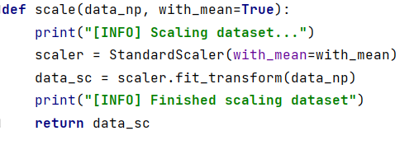
Scaling the Dataset
The dataset has been scaled using a StandardScaler.
The Scaler has the purpose of centering the samples around 0, by subtracting their mean, sample by sample
If the parameter
with_mean = True
And divides for their standard deviation, sample by sample
If the parameter
with_svd = True

Slide 9
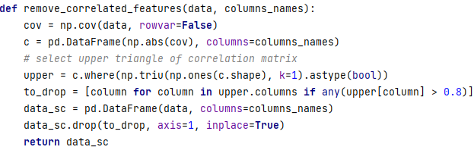
Removing Correlated Features
By plotting the correlation matrix, we removed the features that had a correlation above 80% from the dataset.
Overall, 2020 features were removed.

Slide 10
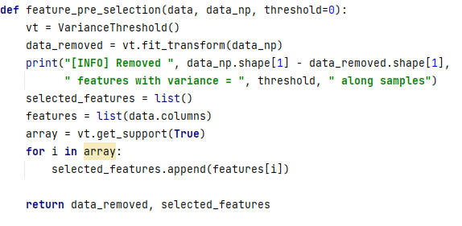
Variance Threshold
We removed features with variance = 0
Starting from the 20531 features in the dataset, up until this step a total of 18511 features were left.
By removing the features whose values were the same in all the samples, the result was a dataset with 18242 features…
Successfully removing 269 features using Variance Threshold

Slide 11
Data Pre-Processing (Unsupervised approach)
1
Check for “Not Available” or “Null” values
3
Variance Threshold
2
Remove outliers
Notes:
No remove correlated features poiché abbiamo scelto la pca e inoltre non scaliamo i dati in quanto si hanno problemi di separabilità
Variance threshold ha rimosso 269 features, quindi lavoriamo con 20262 features

Slide 12
Clustering
02

Slide 13
PCA
02

Slide 14
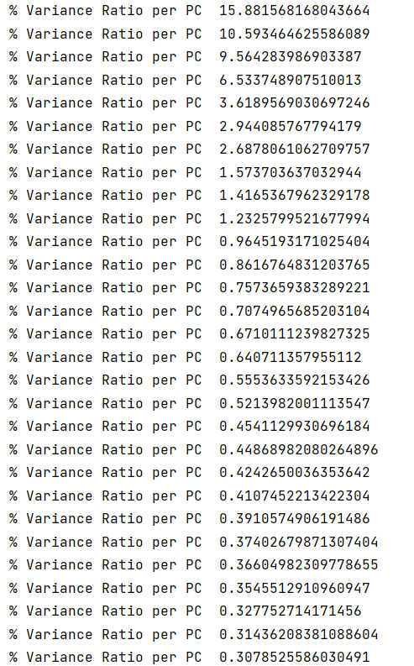
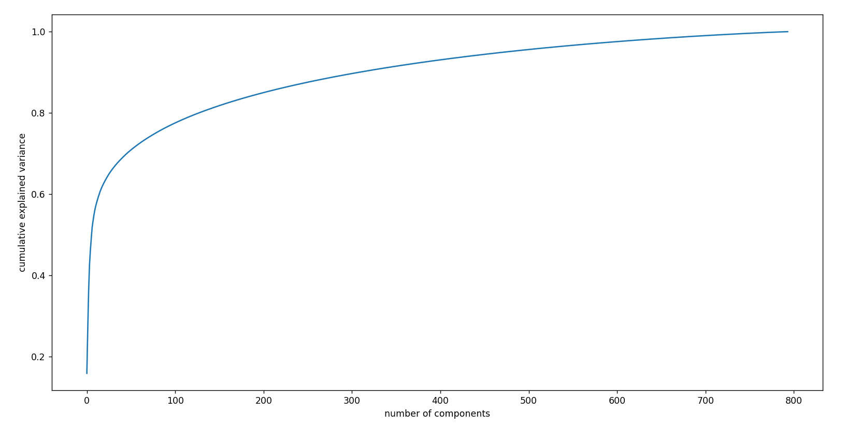
PCA
Since the number of features is high, p>>n, before performing the clustering we decided to use the PCA algorithm to reduce the dimensionality of the space.
Notes:
Siamo partite da 794 pca components, abbiamo visto questo plot con le varianze, e deciso di selezionare solo le prime 10

Slide 15
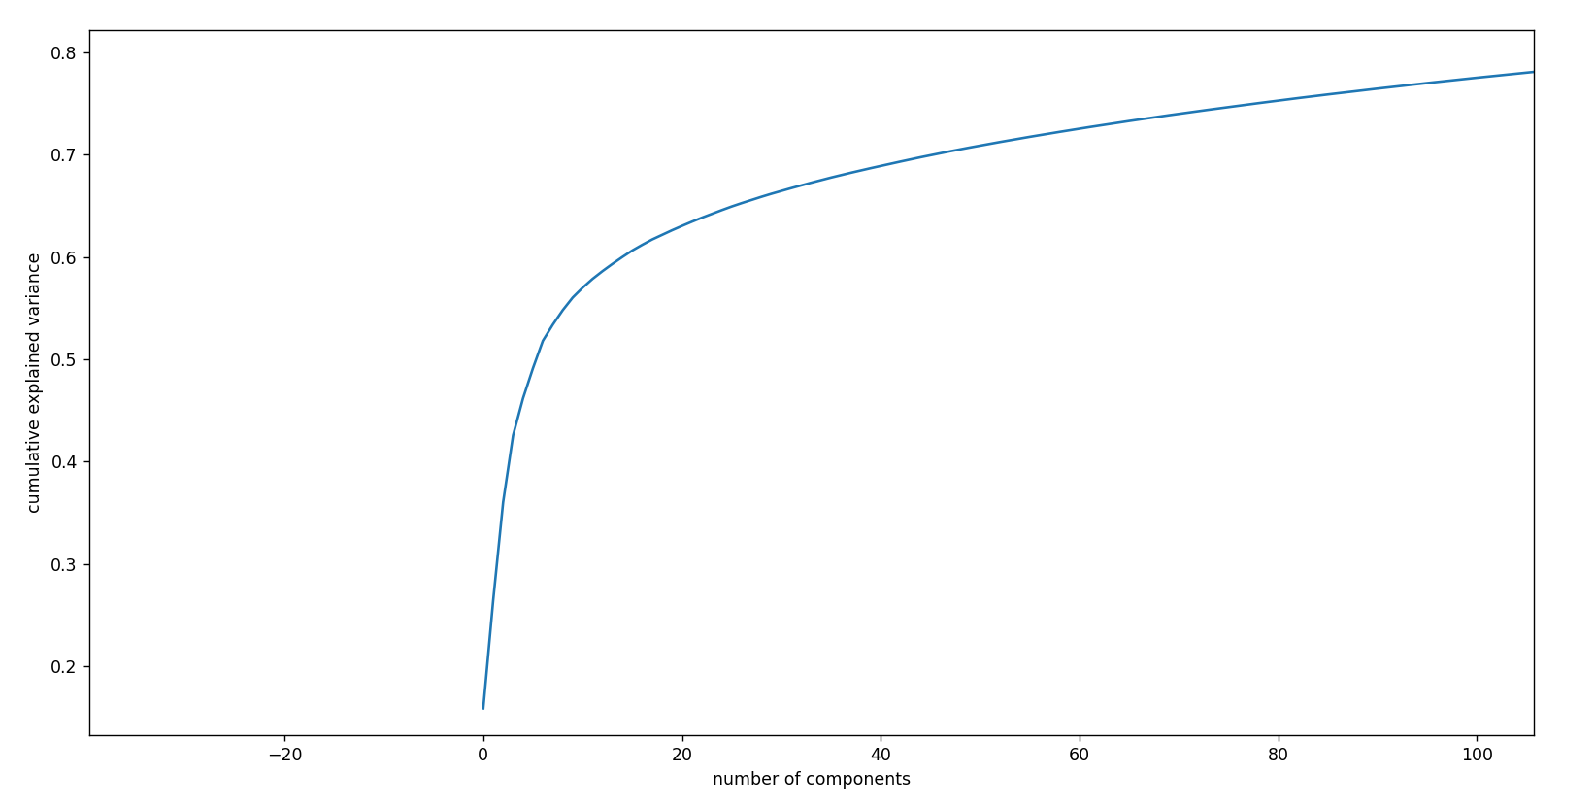
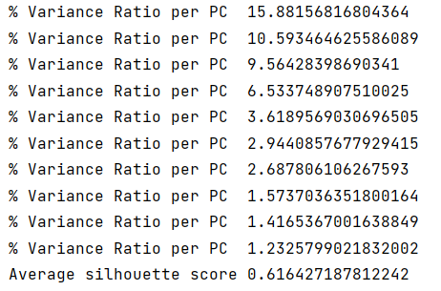
PCA
Since the number of features is high, p>>n, before performing the clustering we decided to use the PCA algorithm to reduce the dimensionality of the space.

Slide 16
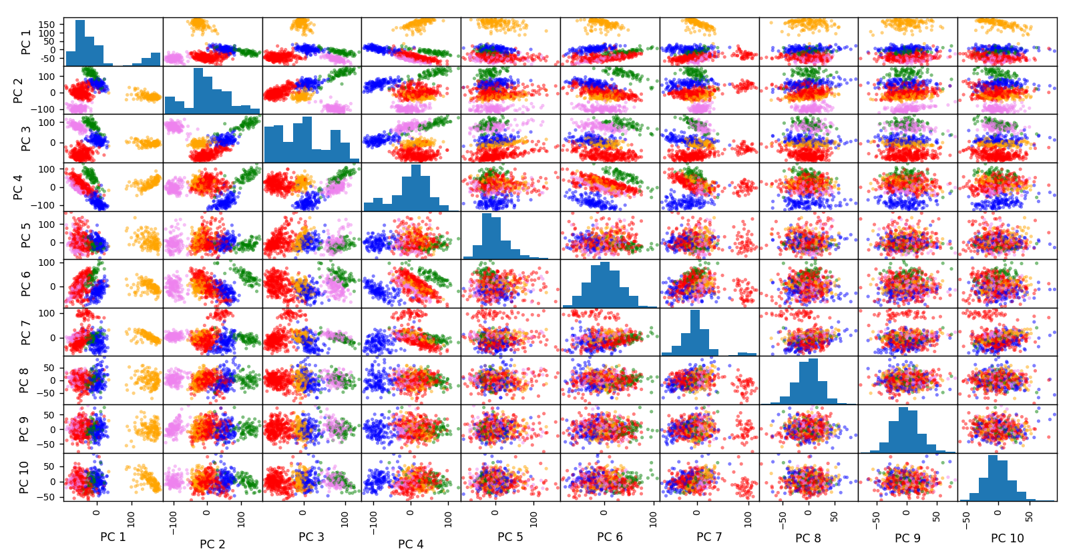
Scatter Plot

Slide 17
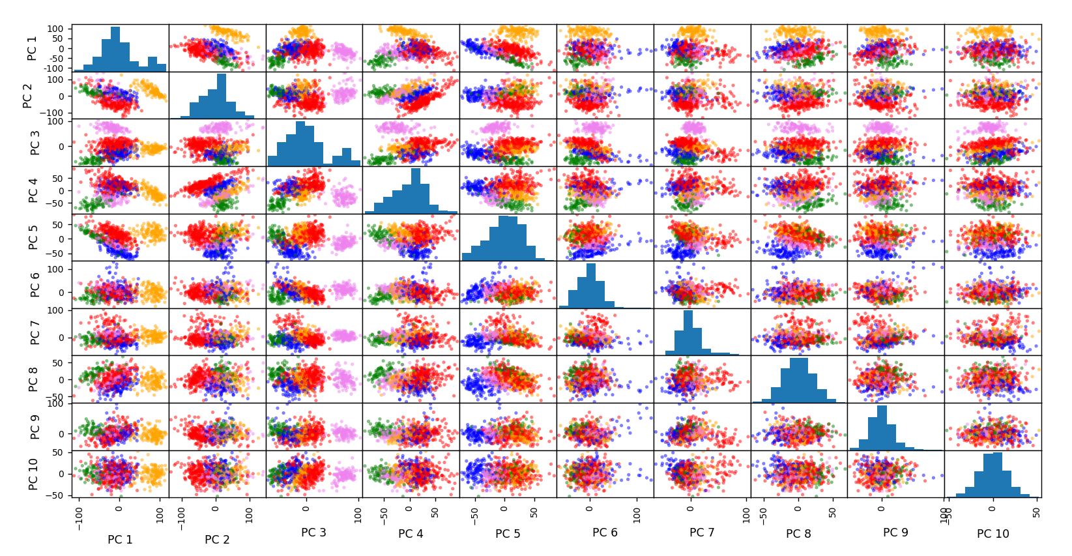
PCA – Scaled Data

Slide 18
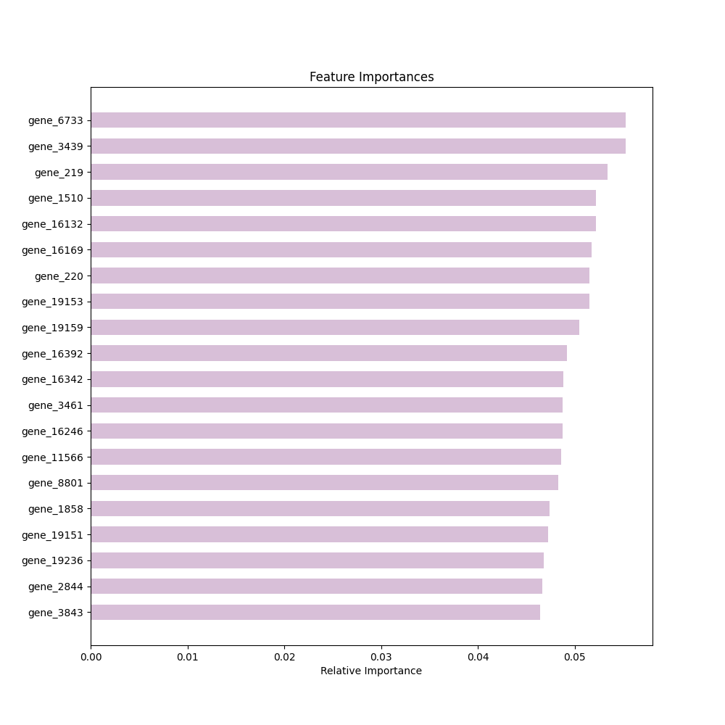
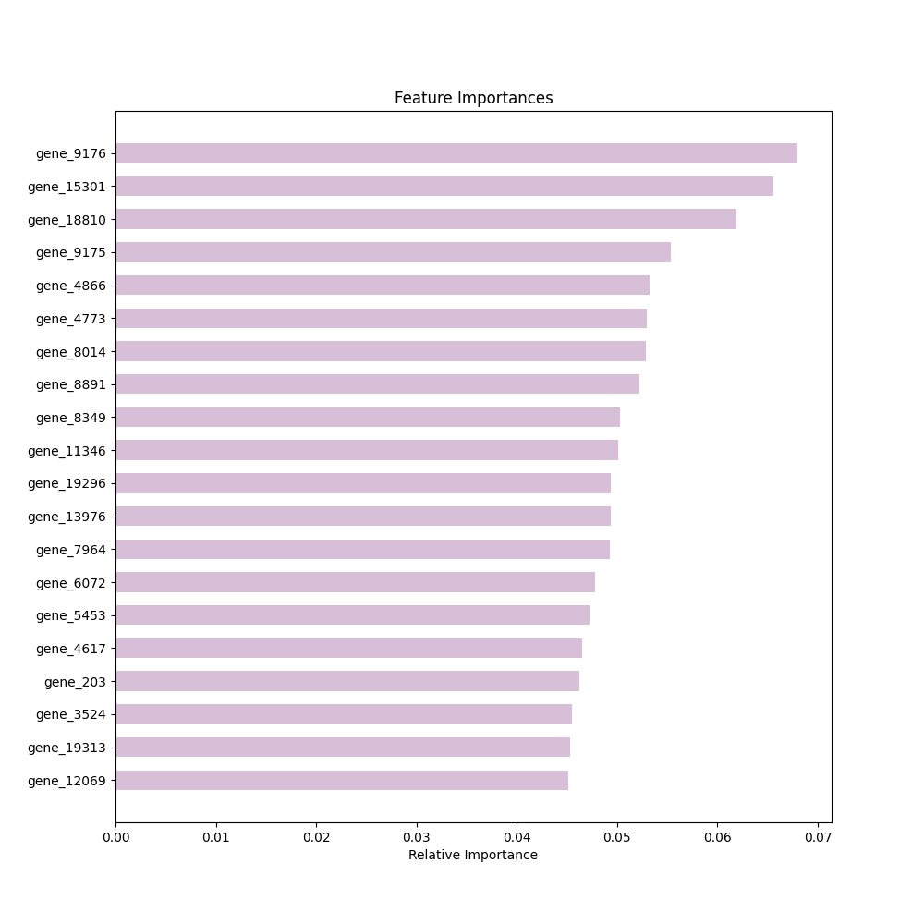
PC1
PC3

Slide 19
K - Means
02

Slide 20
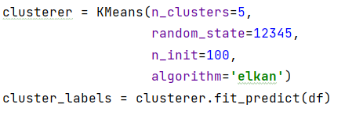
K - Means
K - Means
The number of clusters, n_clusters = 5;
Method for initialization: ‘k-means++’;
Number of times the k-means algorithm is run with different centroid seeds, n_init = 100;
Random number generation for centroid initialization: 12345;
K-means algorithm to use: “elkan”, more efficient on some datasets with well-defined clusters;
The number of features to consider when looking for the best split.
Notes:
‘k-means++’ : selects initial cluster centroids using sampling based on an empirical probability distribution of the points’ contribution to the overall inertia.;
Number of times the k-means algorithm is run with different centroid seeds, n_init = 100; The final results is the best output of n_init consecutive runs;

Slide 21
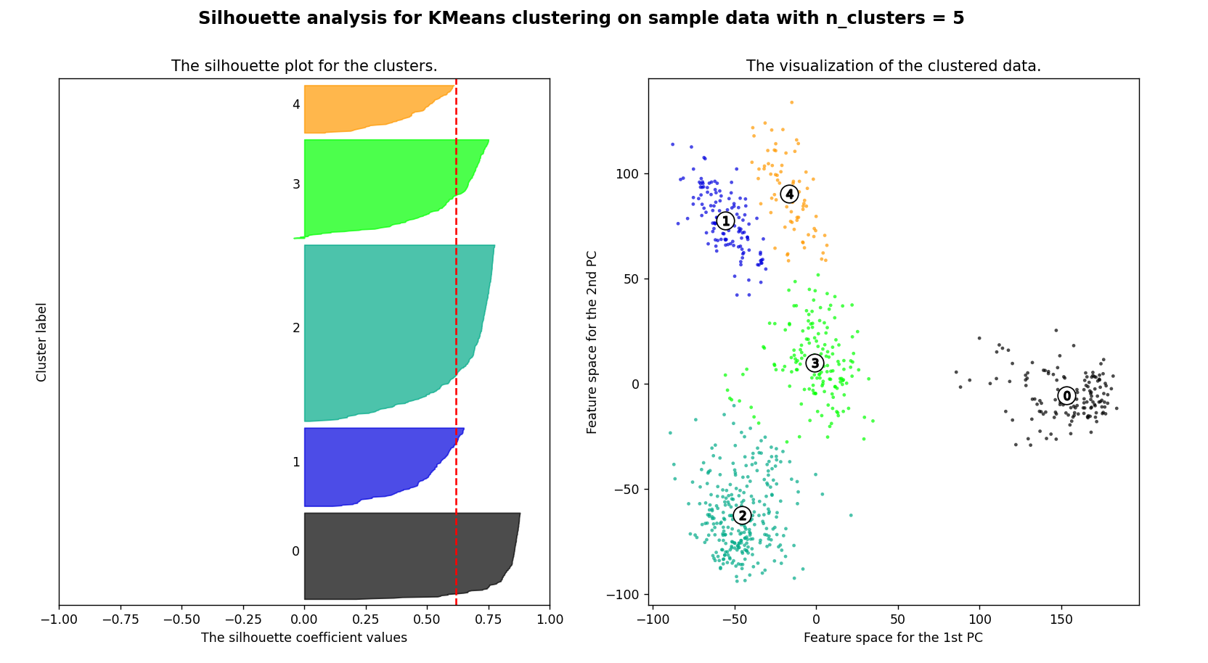
average silhouette score 0.616

Slide 22
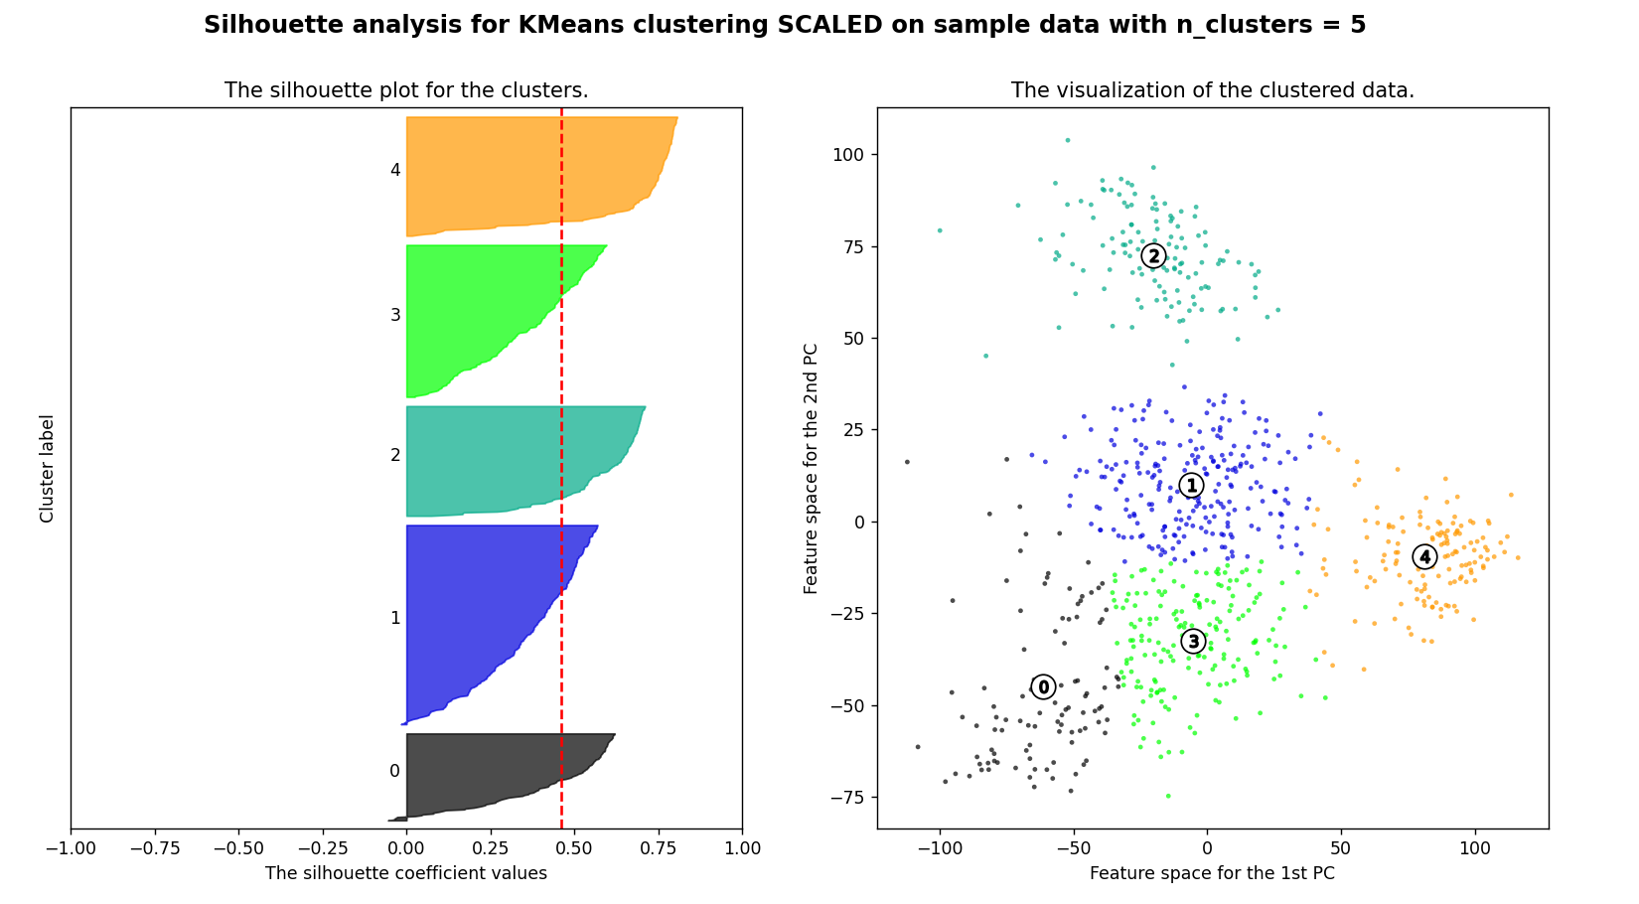

Slide 23
Agglomerative Clustering
02

Slide 24
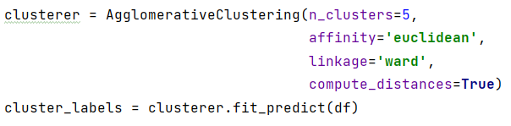
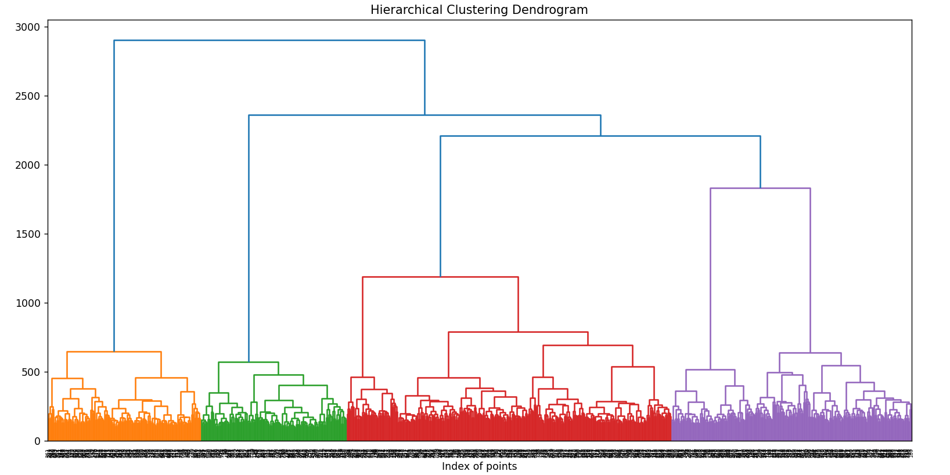
Agglomerative Clustering
The number of clusters, n_clusters = 5;
Linkage criterion to use: ‘ward’, that ’ minimizes the variance of the clusters being merged;
The metric to use when calculating distance between instances in a feature array. If linkage is “ward”, only affinity: “euclidean” is accepted;
Computes distances between clusters: True, this can be used to make dendrogram visualization.

Slide 25
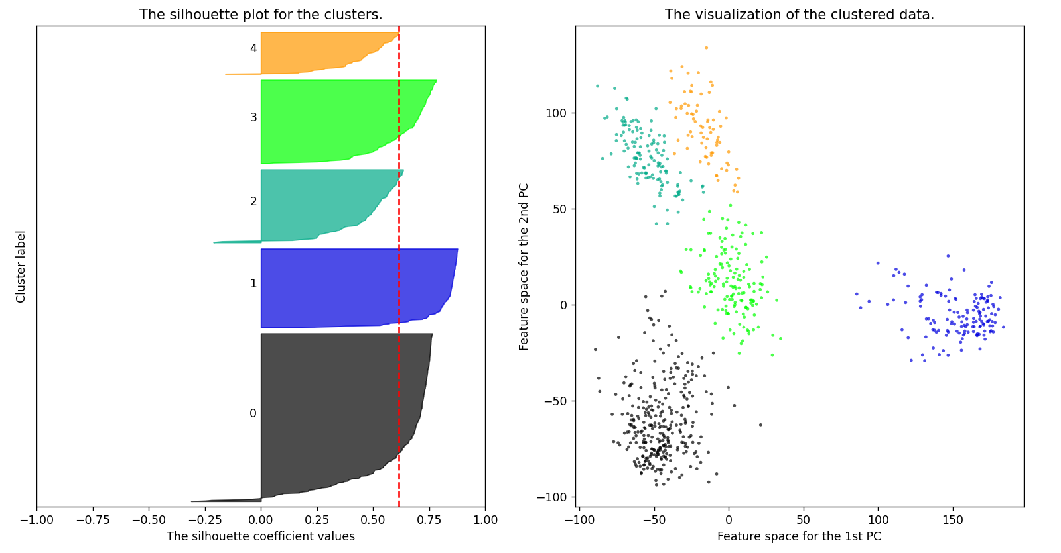
Silhouette Analysis for Agglomerative Clustering on sample data with n_clusters = 5
average silhouette score 0.614

Slide 26
Classification
03

Slide 27
Random Forest
03

Slide 28
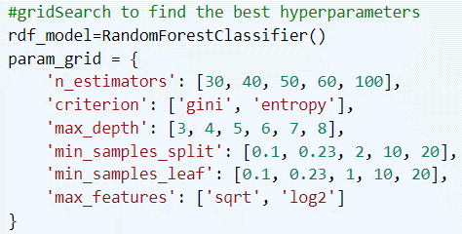
Random Forest
First, we performed Grid Search to find the best hyper parameters for the dataset.
We tested different combinations of:
The number of trees in the forest;
The function to measure the quality of a split;
The maximum depth of the tree;
The minimum number of samples required to split an internal node;
The minimum number of samples required to be at a leaf node;
The number of features to consider when looking for the best split.
GridSearchCV algorithm with CV = 4

Slide 29
Support Vector Classifier
03

Slide 30
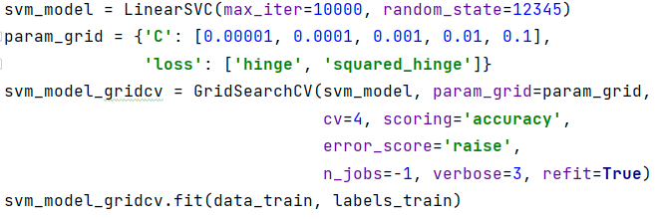
Support Vector Classifier
First, we performed Grid Search to find the best hyper parameters for the dataset.
We tested different combinations of:
Other parameters were left to their default values:
The multi-class strategy since we are dealing with more than two classes: ovr, to train one-vs-rest classifiers;
The norm used in the penalization: l2, since l1 leads to coefficients that are sparse;
The algorithm to either solve the dual or primal optimization problem: True, since the n_samples < n_features;
Other parameters were fixed:
The pseudo random number generation for shuffling the data: 12345;
The maximum number of iterations to be run: 10.000
C, the regularization parameter;
The loss function used.

Slide 31
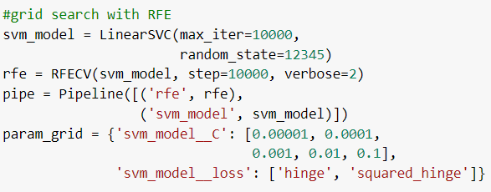
Support Vector Classifier
First, we performed Grid Search to find the best hyper parameters for the dataset.
This was done with a Pipeline, defined by:
LinearSVC;
Recursive Feature Elimination.
The parameters set for the RFE:
The supervised linear estimator: LinearLVC;
The number of features to remove at each iteration: 10.000;
Other parameters were left to their default value:
The number of features to select: None, stops when half of features are selected;
The feature importance getter: auto, selects the features from the ‘coef_’ attribute of the estimator;

Slide 32
Unbalanced Dataset
04

Slide 33
Random Forest
04

Slide 34
Random Forest
First, we performed Grid Search to find the best hyper parameters for the dataset.
We tested different combinations of:
The number of trees in the forest;
The function to measure the quality of a split;
The maximum depth of the tree;
The minimum number of samples required to split an internal node;
The minimum number of samples required to be at a leaf node;
The number of features to consider when looking for the best split.
Best random forest with params:
{'criterion': ‘gini', 'max_depth': 3, 'max_features': 'sqrt, 'min_samples_leaf': 1, 'min_samples_split’: 10, 'n_estimators’: 60}
and score: 0.998
Notes:
Dalla ricercar con grid search, l’albero migliore è stato… con accuracy 99.8% sul training set

Slide 35
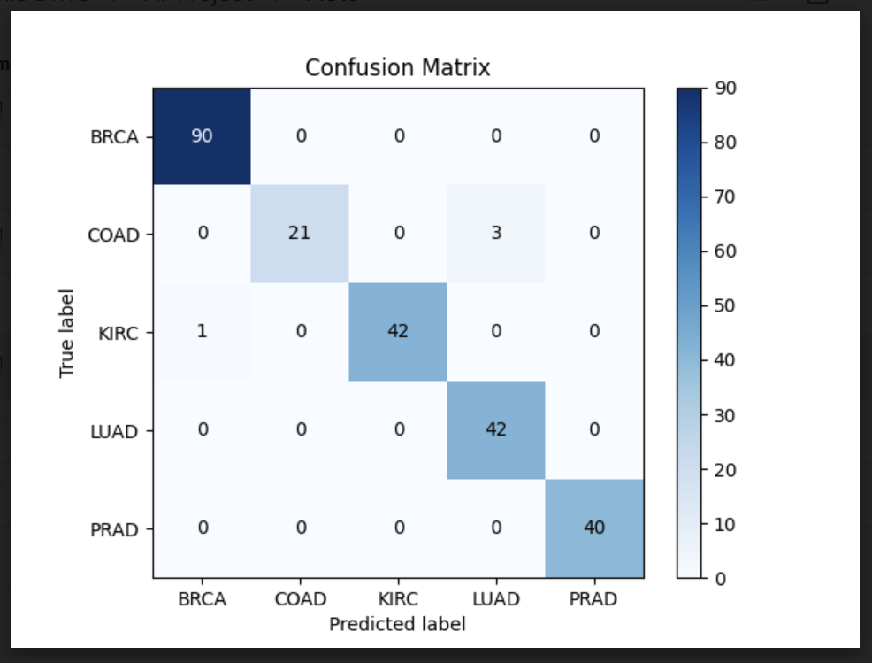
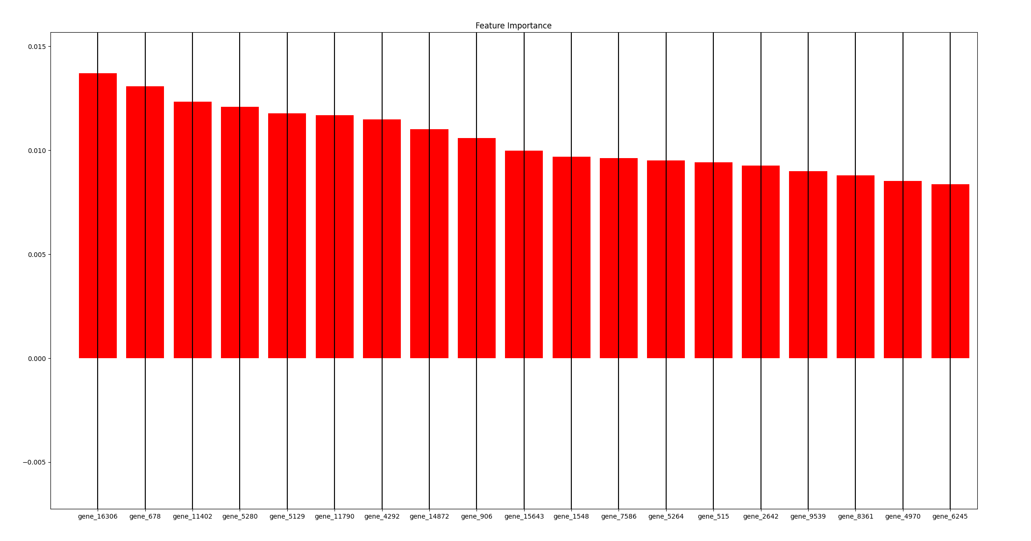
Random Forest
We evaluated the performances of the Random Forest Classifier and checked the feature importance to choose a threshold to apply to select features.
Notes:
Sul test set le performance di random forest sono state del 97% di balanced accuracy score, con pochi errori sulla classe meno rappresentata.
A destra, il plot delle importanze delle feature, da cui abbiamo potuto selezionare una threshold da applicare per effettuare feature selection ed identificare solo le più importanti.
Guardando il plot, abbiamo scelto una threshold di 0.008

Slide 36
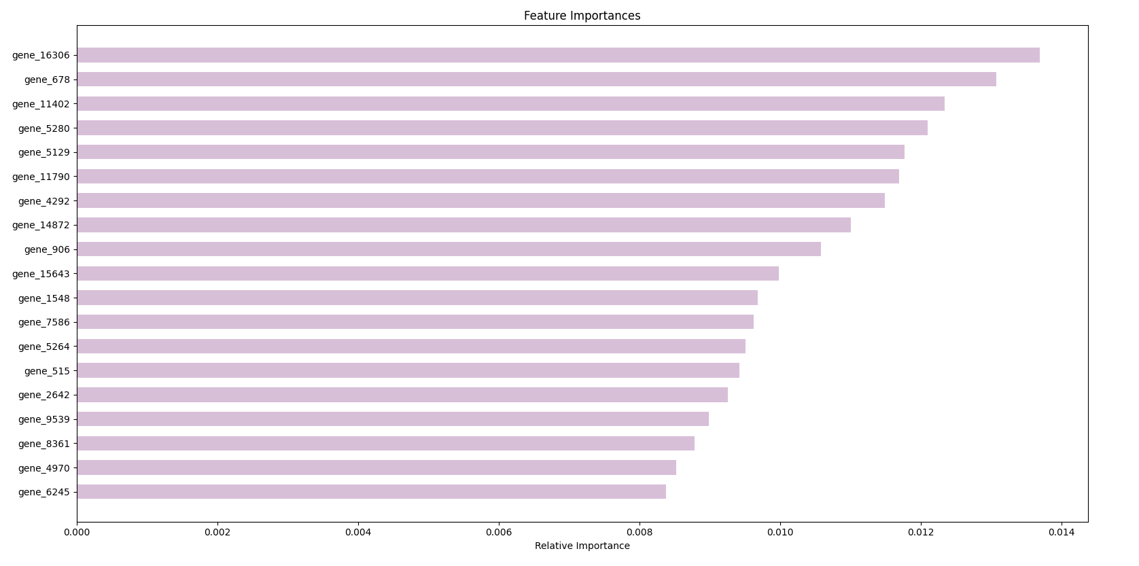
Random Forest
With threshold 0.008, 19 features were selected.
Notes:
Con questa threshold, abbiamo selezionato 19 features: le più importanti tra tutte le classi.

Slide 37
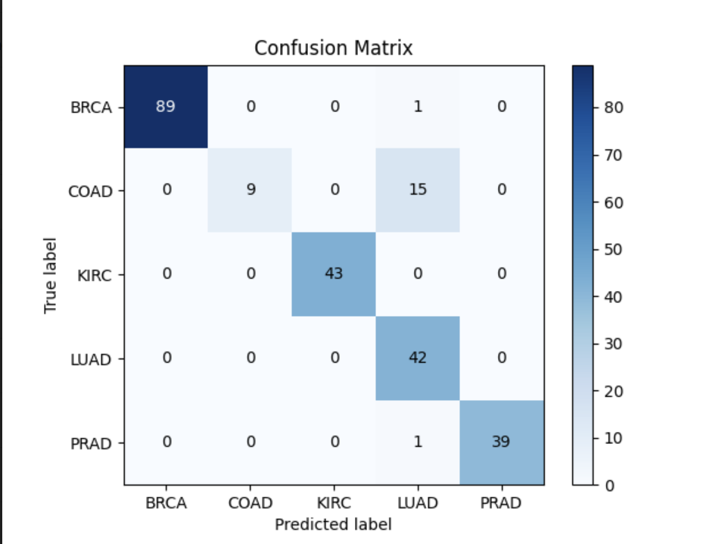
Random Forest
We evaluated the performances of a new Random Forest Classifier, only trained with the most relevant 19 features found:
Notes:
Abbiamo poi provato ad addestrare lo stesso modello di random forest con le 19 feature selezionate, ed ottenuto un’accuracy del 86%, gli errori si notano soprattutto per la classe COAD
Perché probabilmente essendo la meno rappresentata, il modello non ha potuto imparare, come per le alter classi, le feature necessarie per classificare quei sample, che quindi non fanno parte delle 19 selezionate

Slide 38
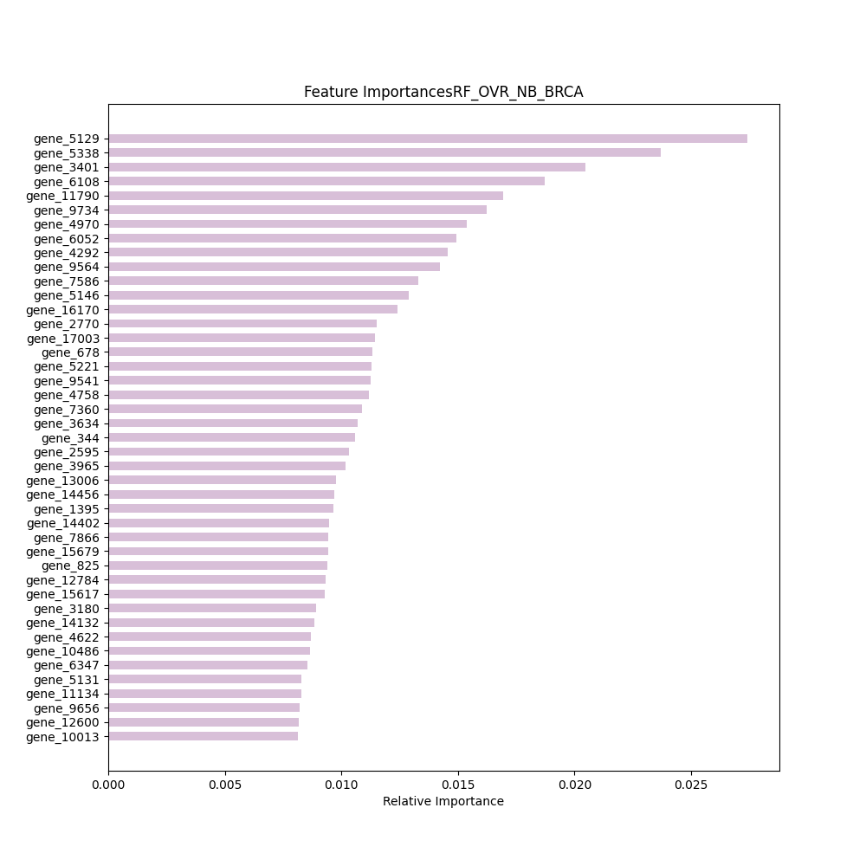
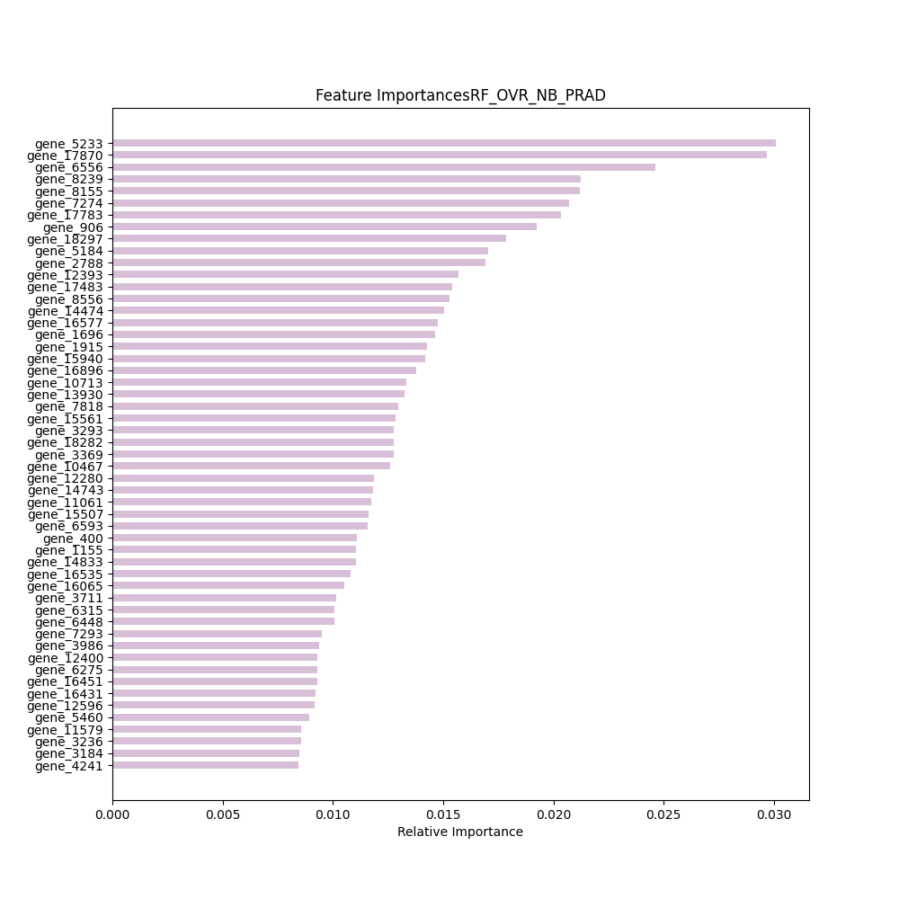
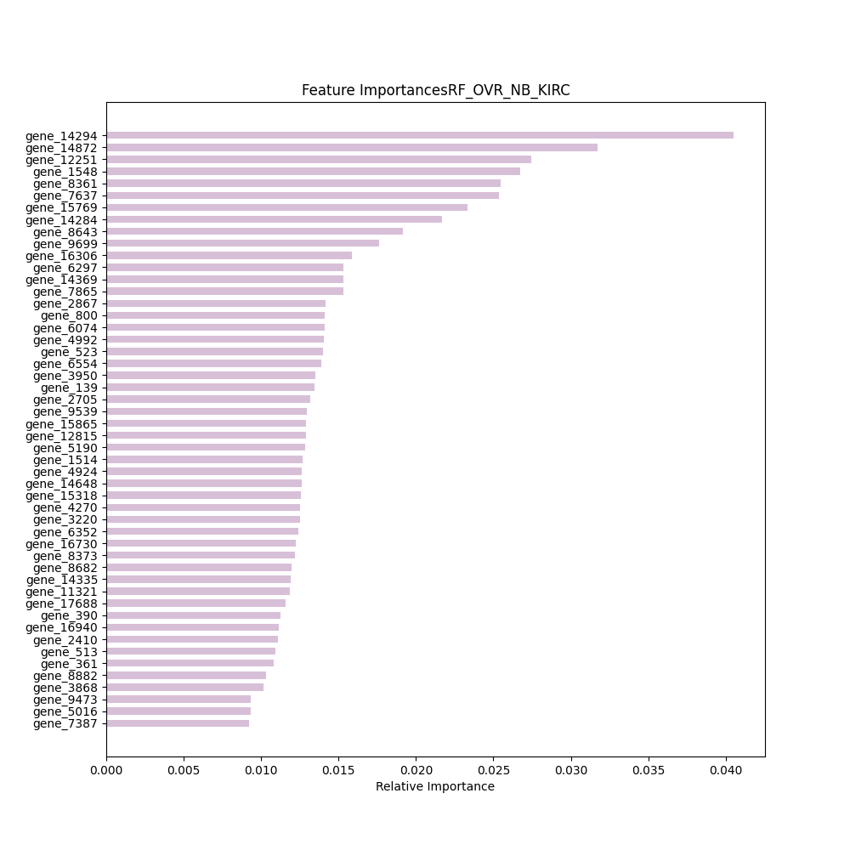
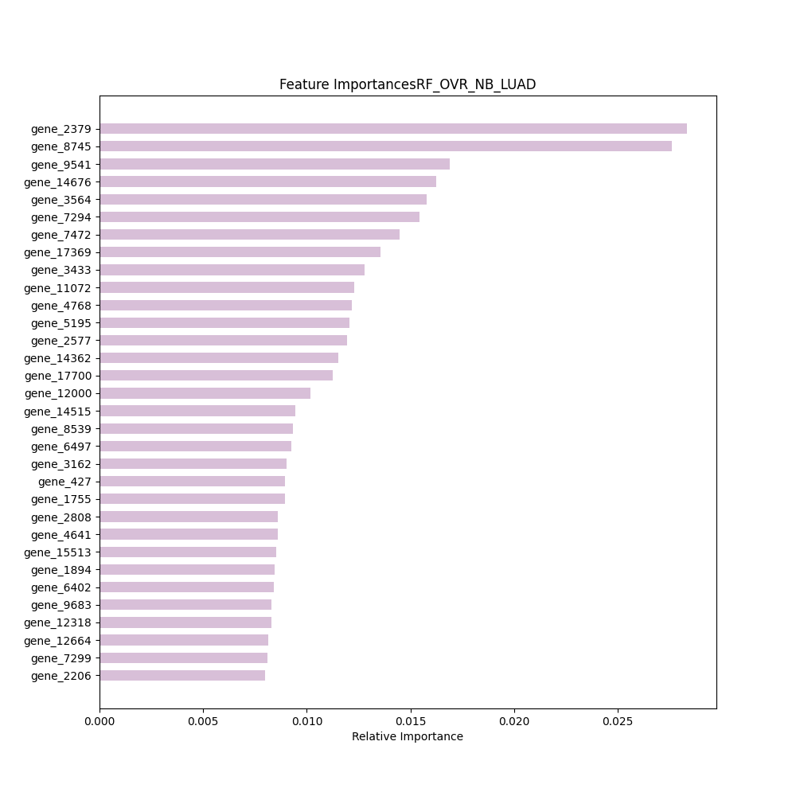
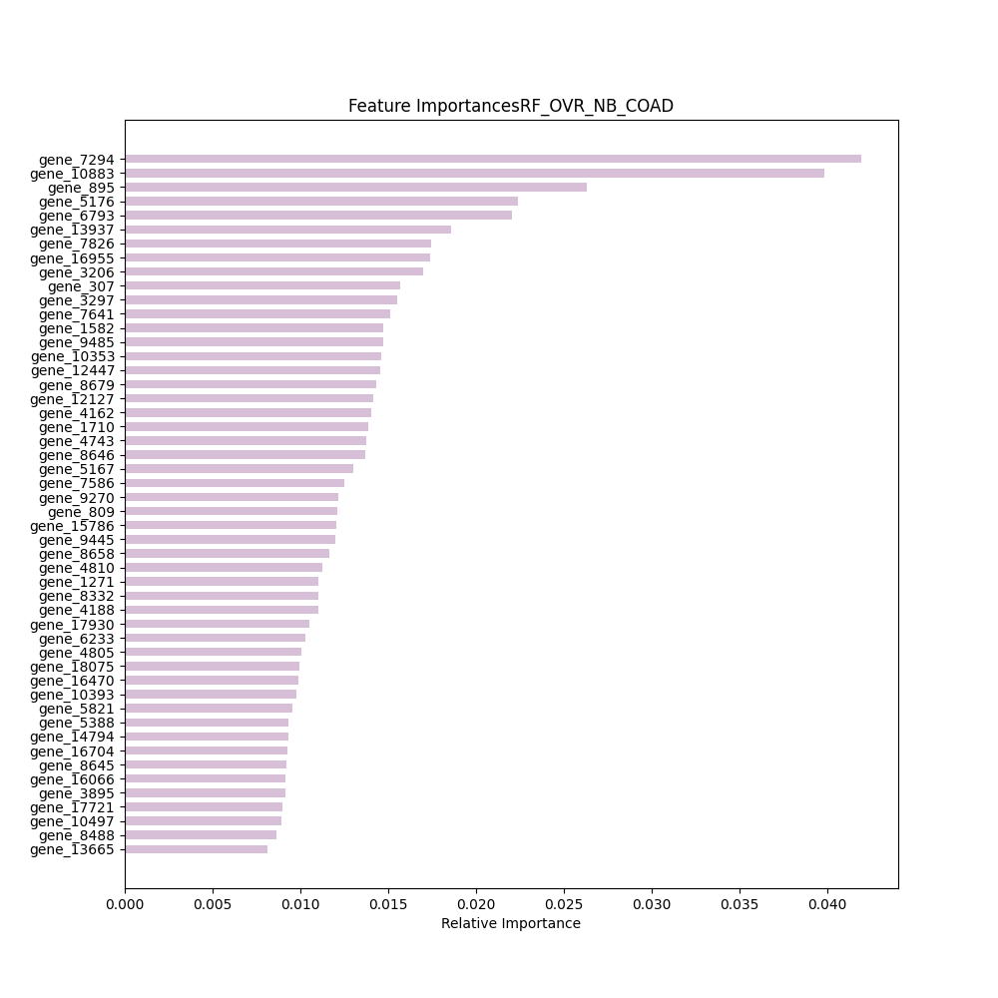
Random Forest
To select the most relevant features for each class, the classifier was trained using the OneVsRestClassifier, that fits 5 Random Forests, one for each class.
{'criterion': ‘gini’, ‘max_depth’: 3, ‘max_features’: ‘sqrt, ‘min_samples_leaf’: 1, ‘min_samples_split’: 0.1, ‘n_estimators’: 30}
And threshold 0.008
Notes:
Per ottenere un riferimento alle feature per le single classi, abbiamo invece addestrato random forest facendo uso di un classificatore One vs rest, che ha addestrato rispettivamente 5 classificatory diversi per ottenere le feature importanti solo per la classe di riferimento dello specific albero

Slide 39
Support Vector Classifier
04

Slide 40
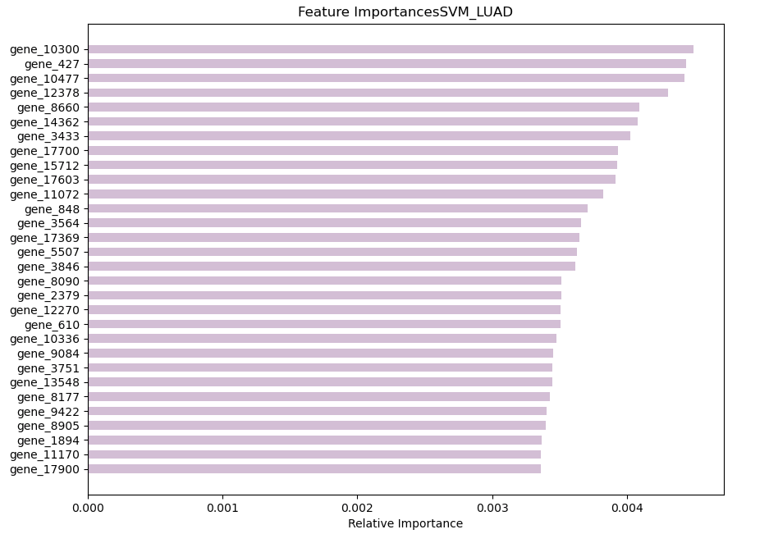
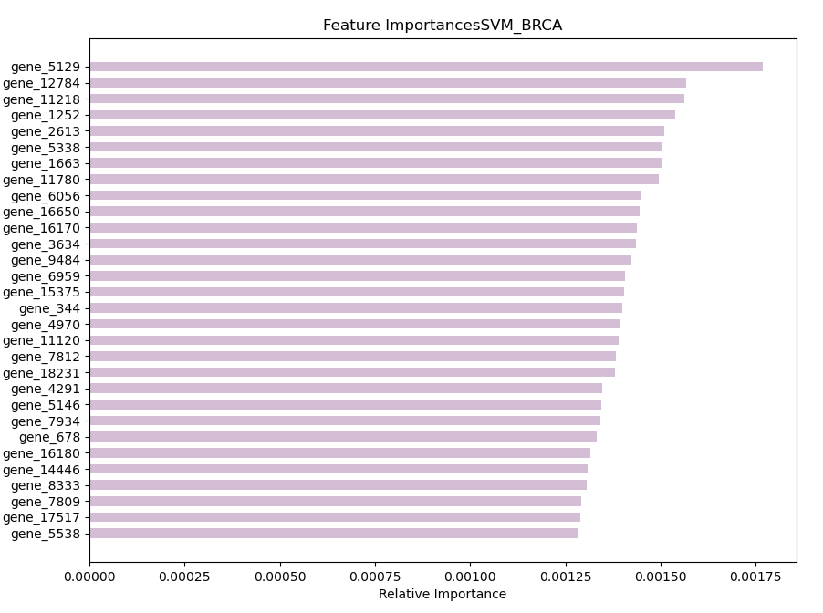
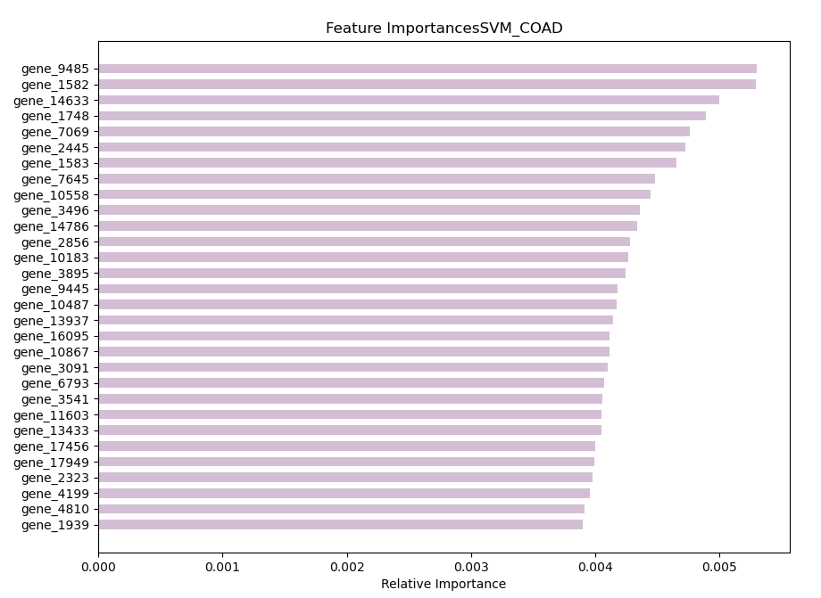
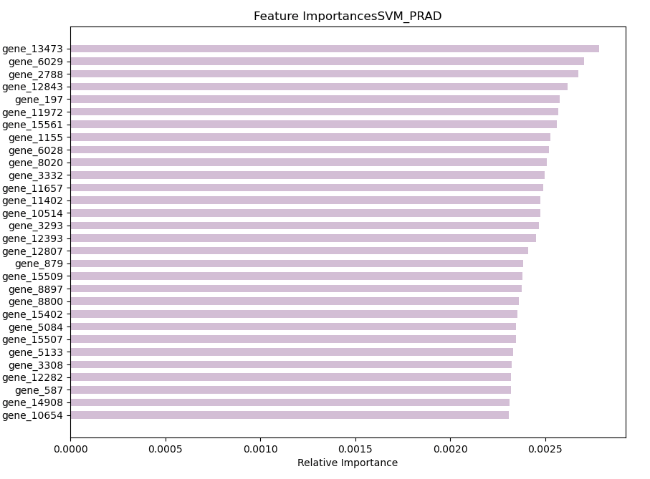
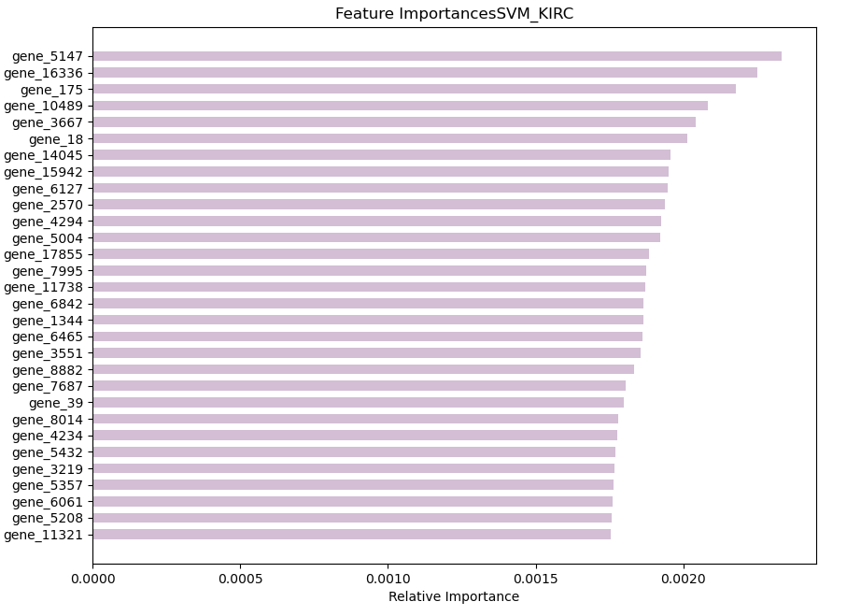
Support Vector Classifier
Best LinearSVC with params:
{ ‘C’: 0.0001 , ‘loss’: ‘hinge’}
and score: 1.0
In this case, the features are selected per class, and correspond to:
Notes:
Il miglior svc è stato quello con parametri---e accuracy 100%, in questo caso svc restituisce già le feature importanti distribuite sulle 5 classi

Slide 41
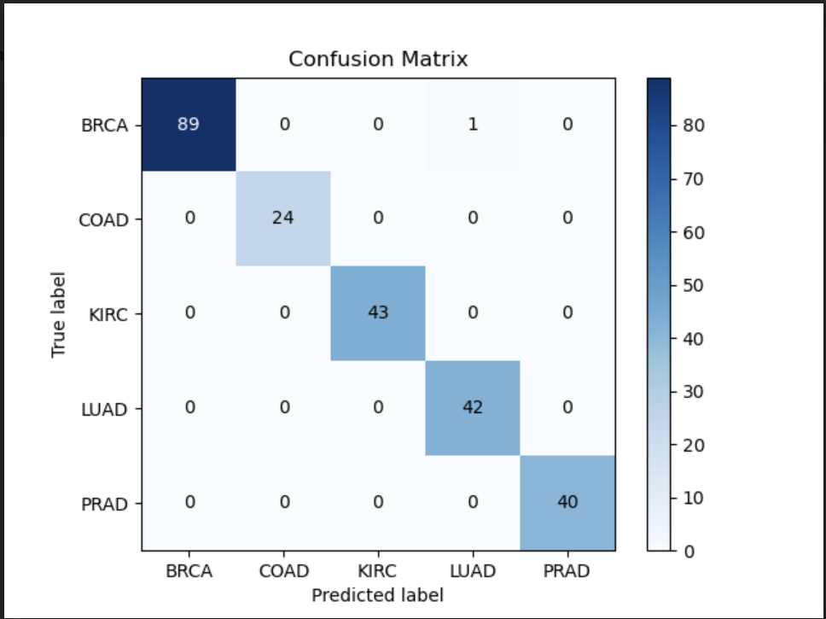
Support Vector Classifier
The results of the SVM model on the test set:

Slide 42
Dataset Balancing
05

Slide 43
SMOTE
05

Slide 44
SMOTE
The experiments have been repeated after a balance of the given dataset.
Over Sampling
Sampling information to resample the data set: sampling_strategy: “auto” → “not majority”, to resample all classes but the majority class;
The nearest neighbors used to define the neighborhood of samples to use to generate the synthetic samples, k = 5;
Randomization of the algorithm = 12345;

Slide 45
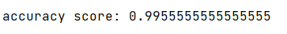
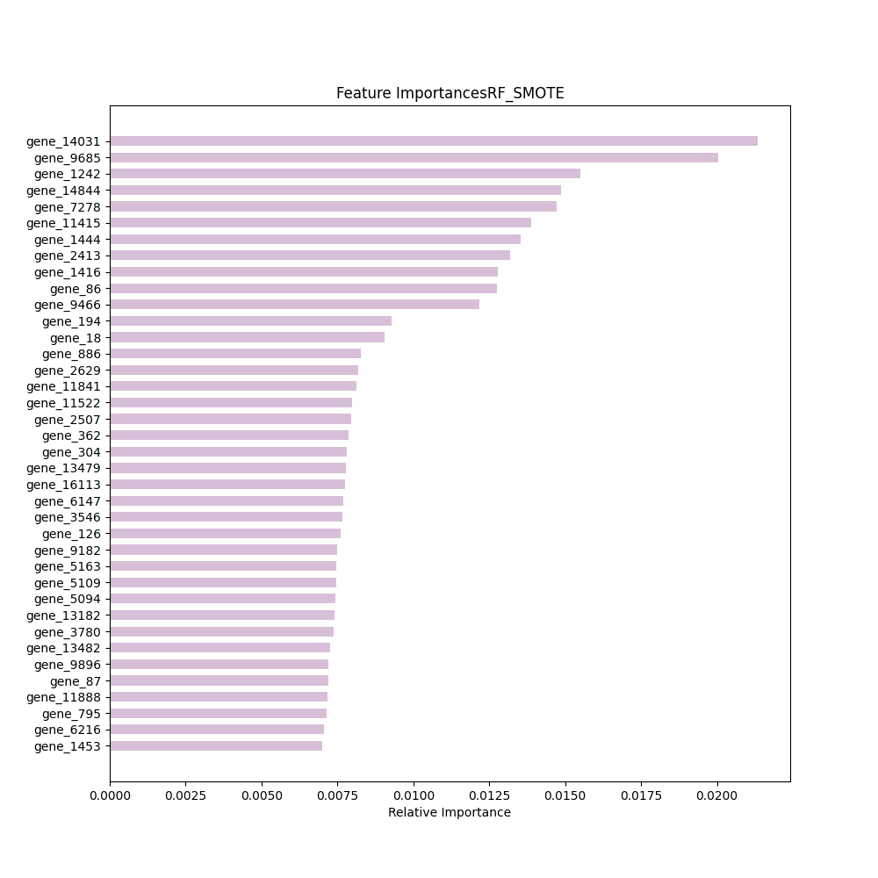
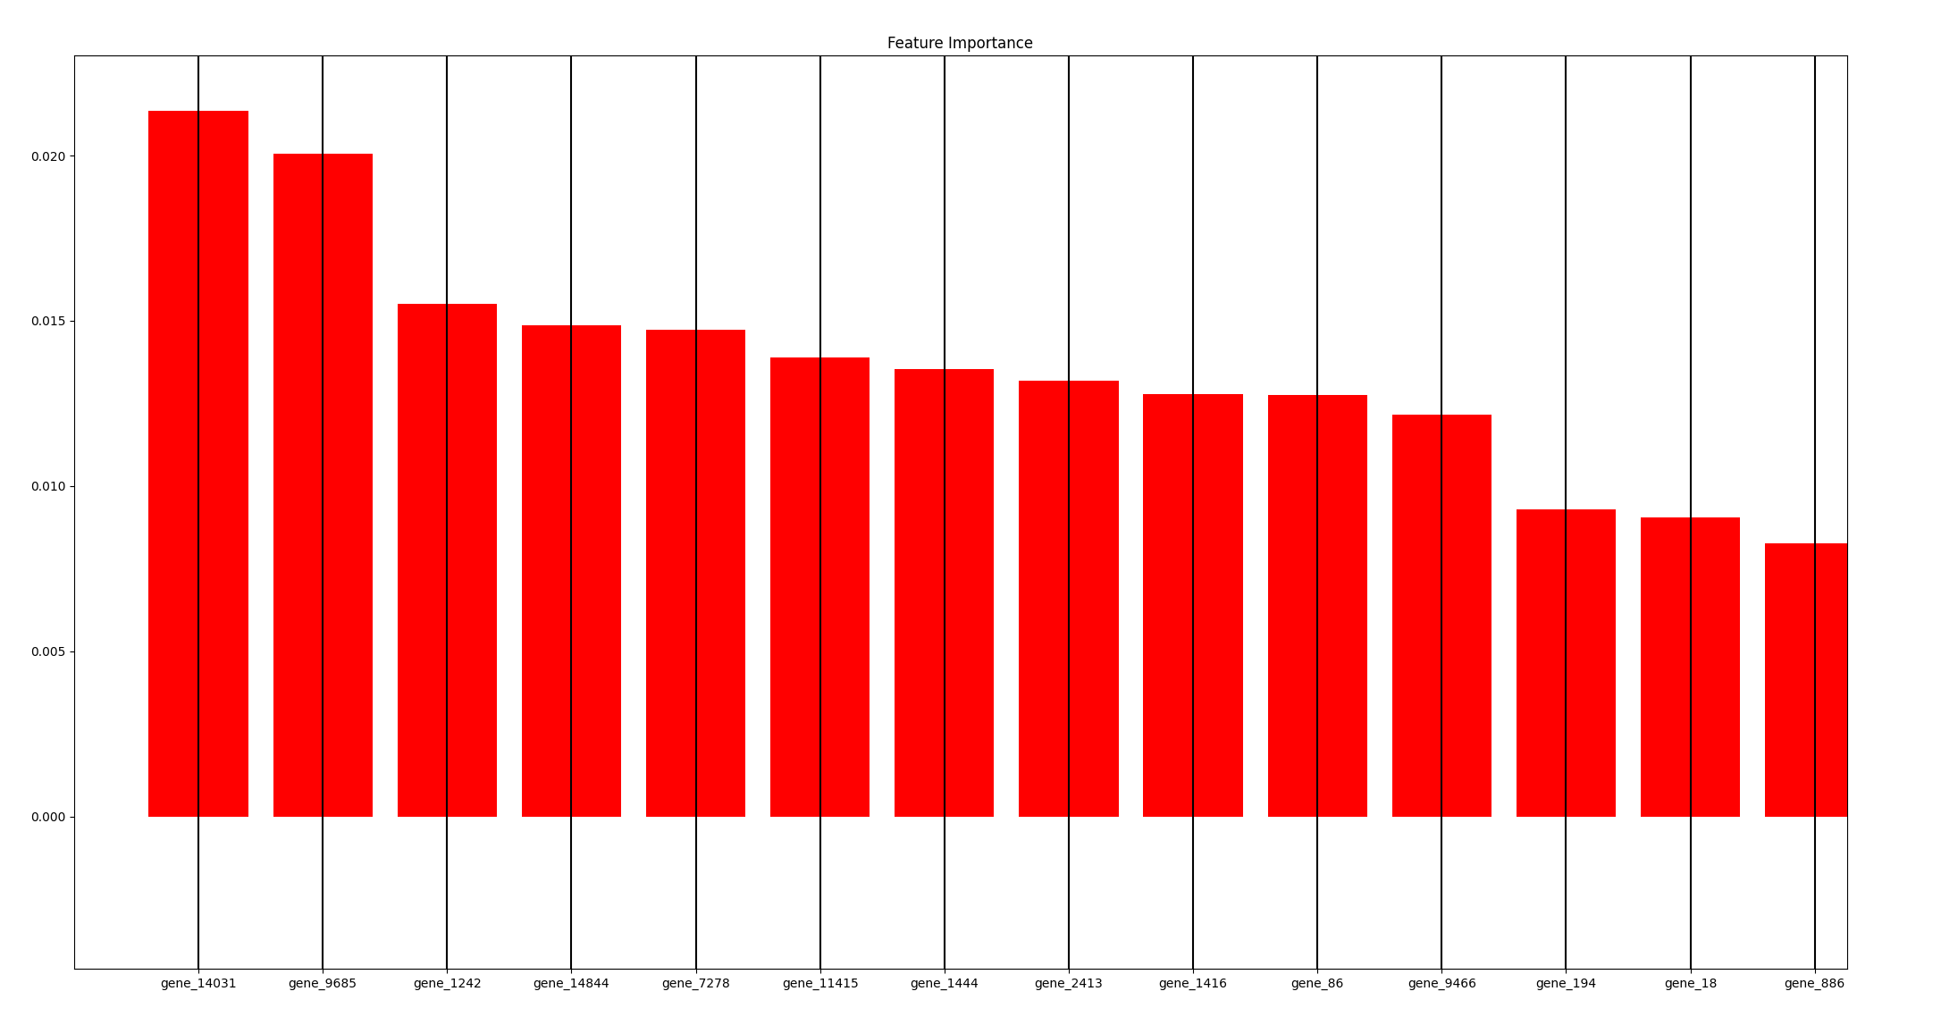
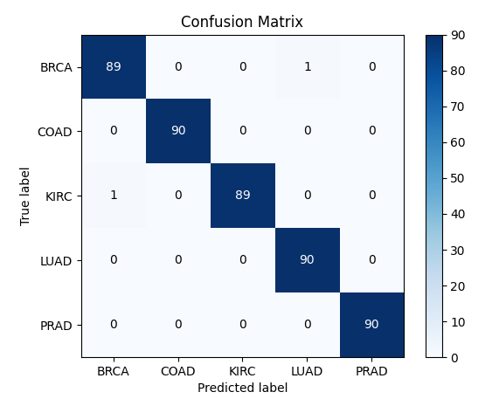
Random Forest
Best random forest with params:
{'criterion': ‘gini', 'max_depth’: 6, 'max_features': 'sqrt, 'min_samples_leaf': 1, 'min_samples_split’: 10, 'n_estimators’: 30}
and score: 0.999
Notes:
Performance di random forest migliorate sul dataset bilanciato, con un’accuracy del 99% sul test set

Slide 46
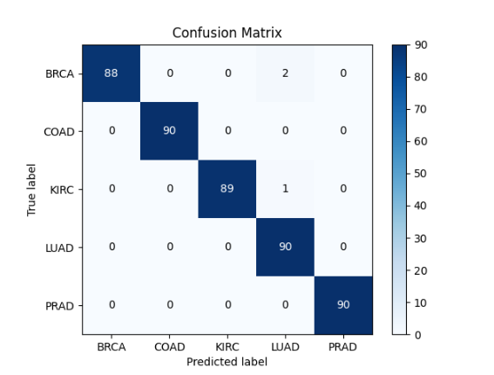
Accuracy score 0.9933
Random Forest - Re-trained

Slide 47
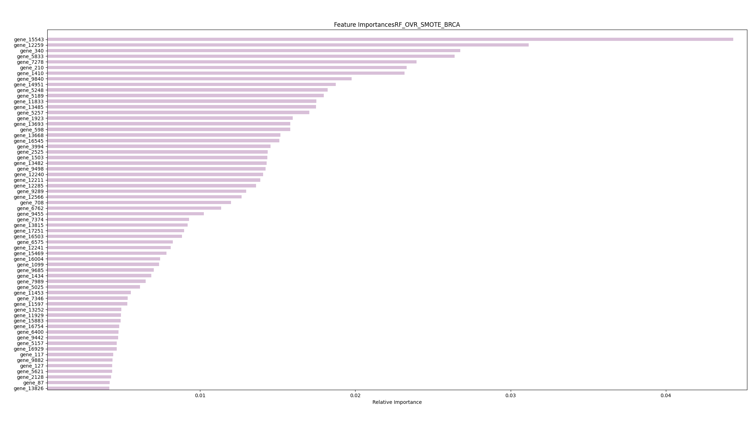
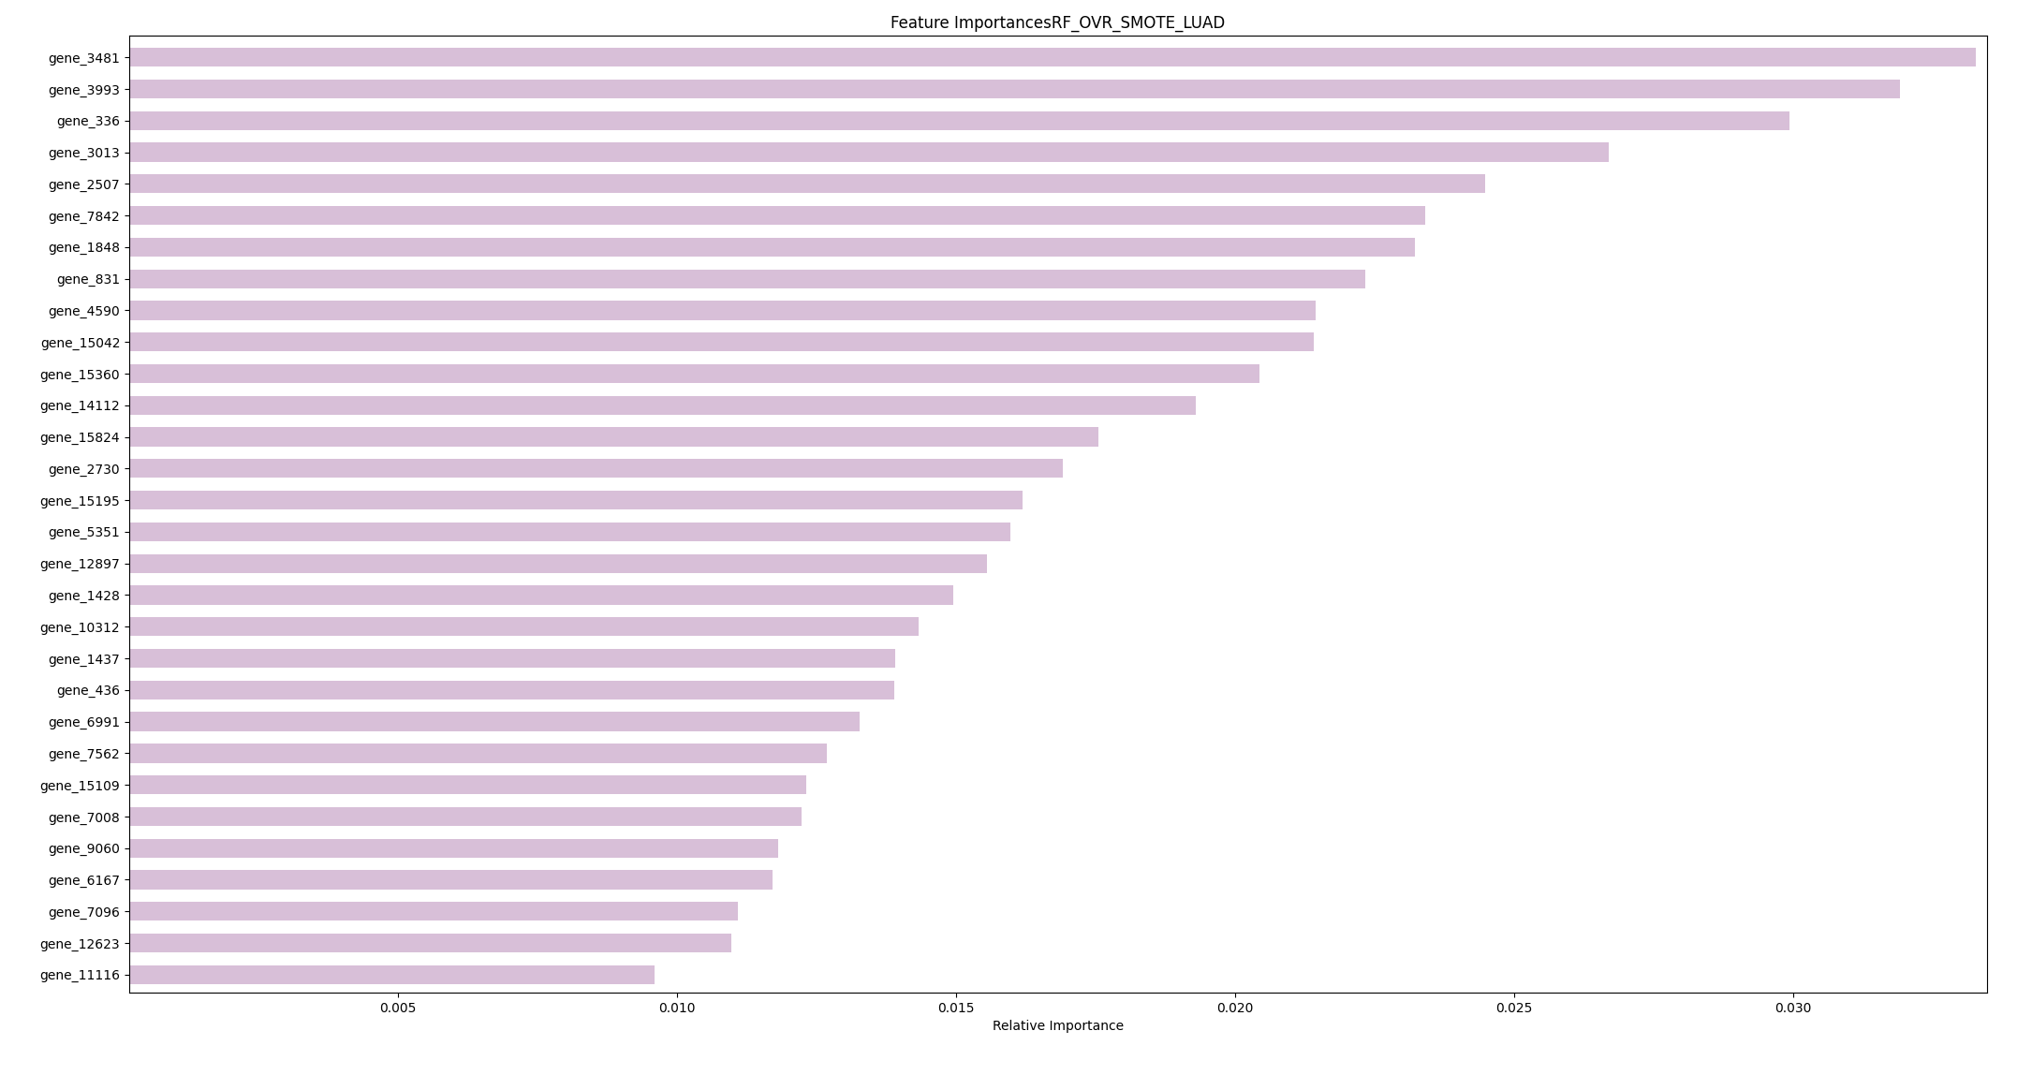
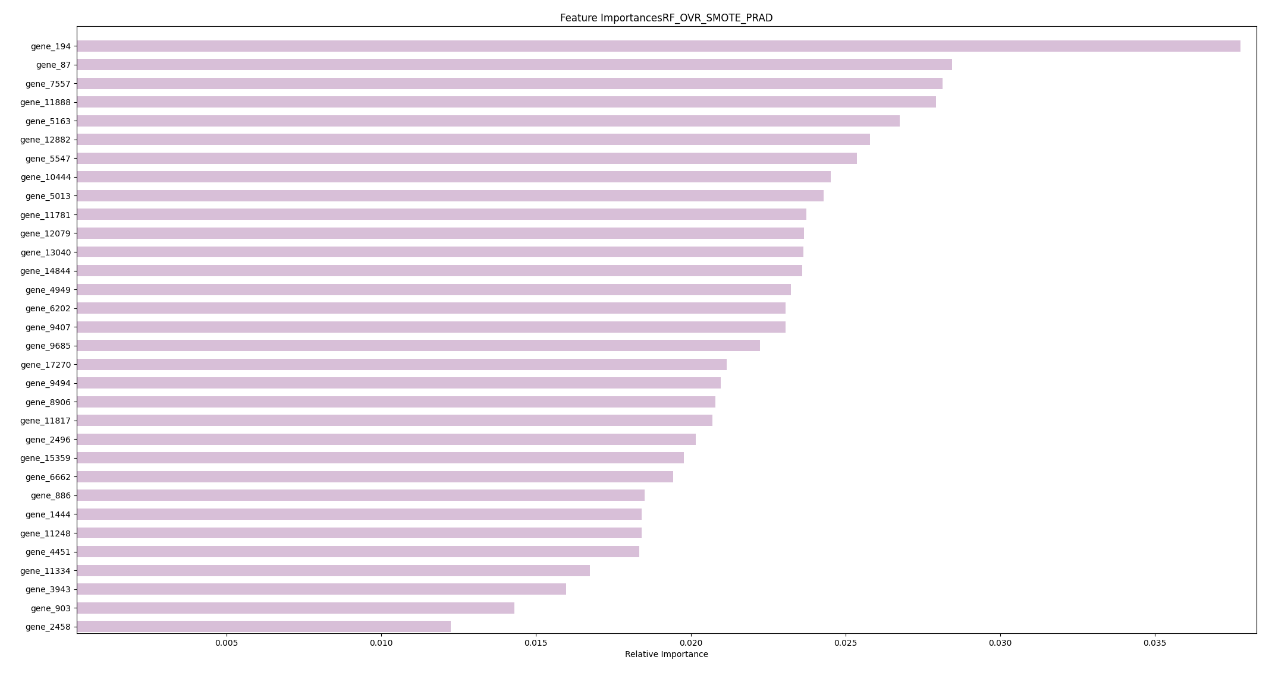
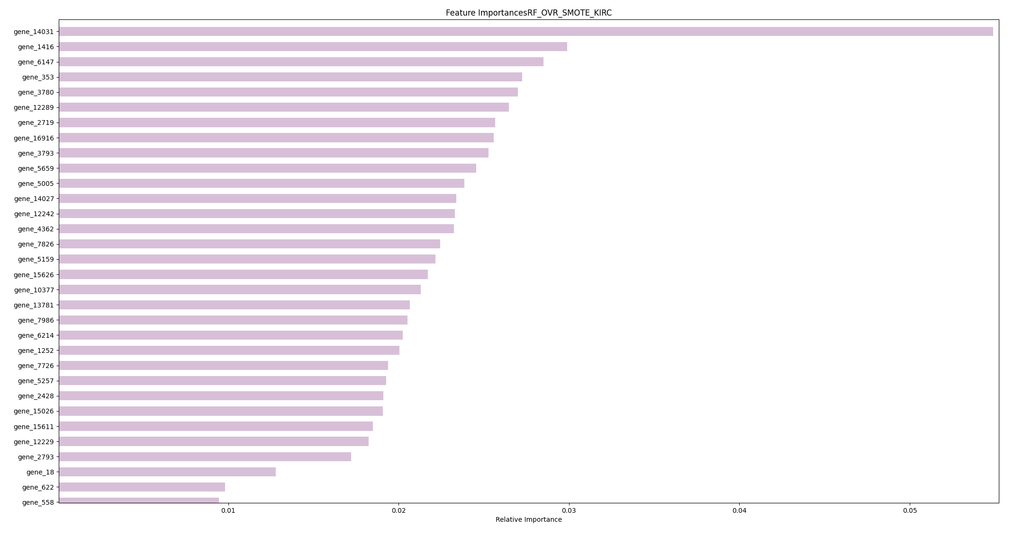
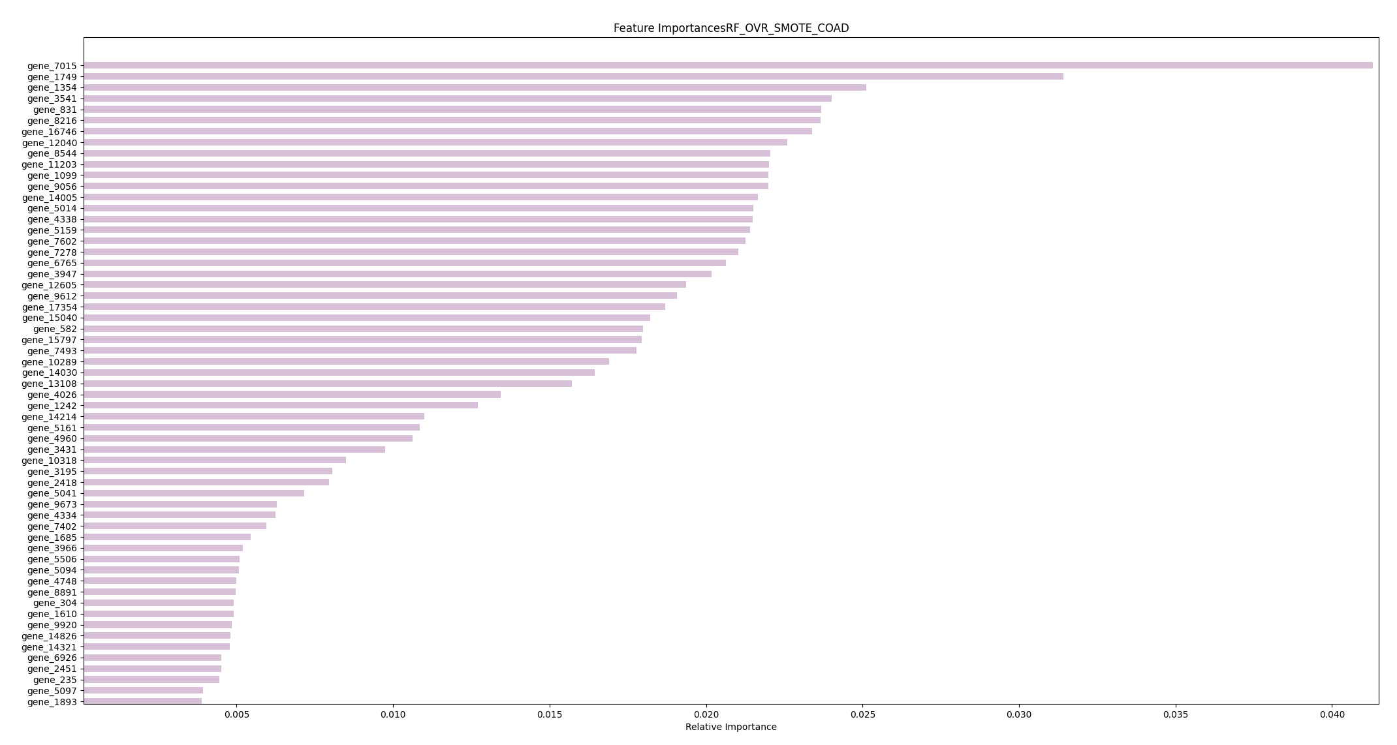
One vs Rest – Random Forest
Notes:
Da dire semplicemente che con il balancing è possibile notare almeno una feature più significativa rispetto alle altre, cosa che non avveniva nel caso di non balanced

Slide 48
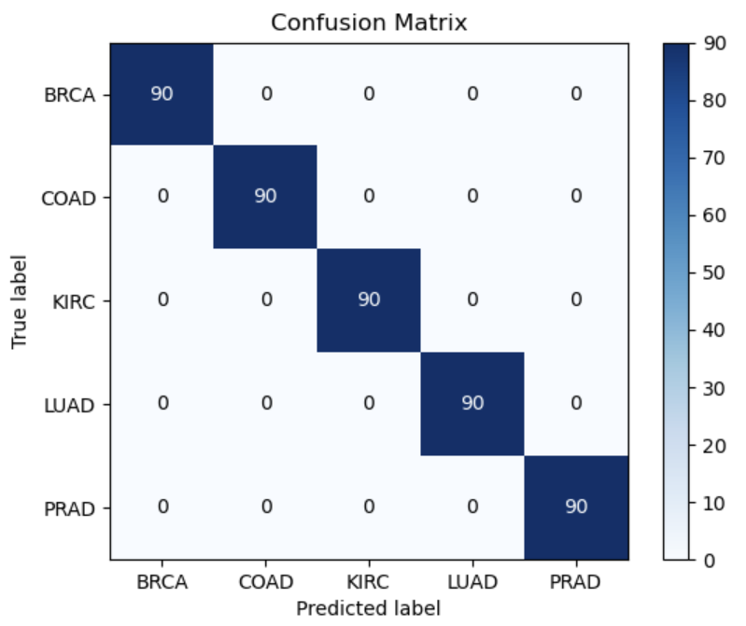
Support Vector Classifier
Best LinearSVC with params:
{ ‘C’: 0.001 , ‘loss’: ‘hinge’}
and score: 1.0
Accuracy score: 1.0

Slide 49
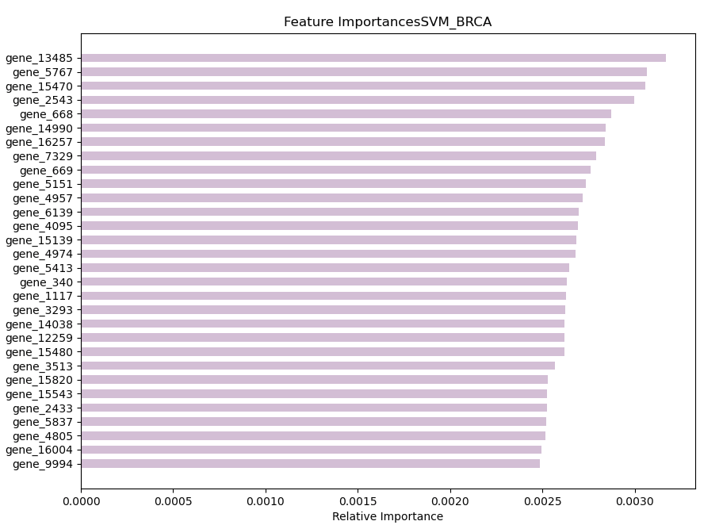
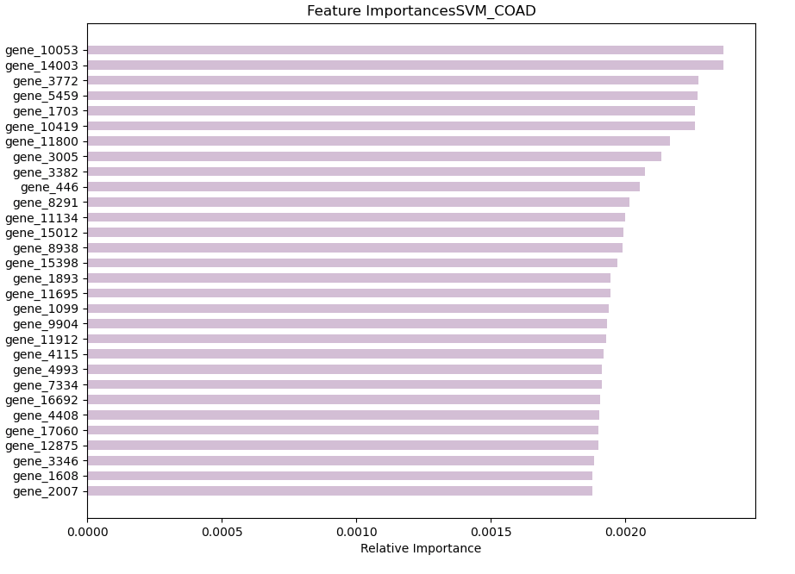
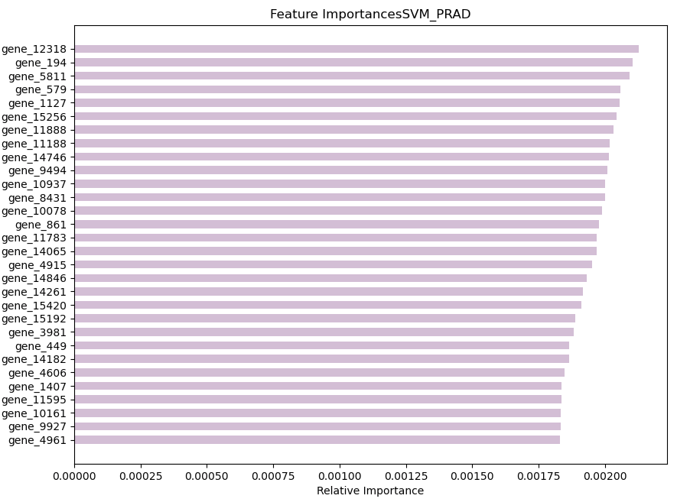


SVC
Notes:
Possiamo dire che rfc in quanto albero soffre dello sbilanciamento delle classi, per cui una volta bilanciate si possono notare quelle feature più importnati.
Svm, invece, non subisce lo sbilanciamento e quindi le performance sono rimaste pressoche le stesse

Slide 50
NearMiss
05

Slide 51
Near Miss
The experiments have been repeated after a balance of the given dataset.
Under Sampling
Sampling information to resample the data set: sampling_strategy: “auto” → “not minority”, to resample all classes but the minority class;
The nearest neighbors used to define the size of the neighbourhood to consider to compute the average distance to the minority point samples, n_neighbours = 3;
Version of the NearMiss to use: 2, selects samples from the majority class for which the average distance to the farthest neighbors is the smallest.

Slide 52



Random Forest
Best random forest with params:
{'criterion’: ‘gini', 'max_depth’: 3, 'max_features': 'sqrt, 'min_samples_leaf’: 0.1, 'min_samples_split’: 0.1, 'n_estimators’: 50}
and score: 1.0
Accuracy Score: 0.991

Slide 53

Random Forest - Re-trained
Accuracy score: 0.974

Slide 54





ONEvsREST

Slide 55

Support Vector Classifier
Best LinearSVC with params:
{ ‘C’: 0.0001 , ‘loss’: ‘hinge’}
and score: 1.0
accuracy score: 1.0

Slide 56





SVC

Slide 57
Final Comparison
Unbalanced Dataset
Models | Accuracy Score
Random Forest | 0.9703
Support Vector Machine | 0.9977
SMOTE Over-Sampling
NearMiss Under-Sampling
Models | Accuracy Score
Random Forest | 0.9955
Support Vector Machine | 1.0
Models | Accuracy Score
Random Forest | 0.9911
Support Vector Machine | 1.0
Notes:
Qua diciamo miglioramento delle performance, sia per rfc (albero) e non cambiano di moltissimo con svm

Slide 58
Comparison with the state of the art
The investigations have been compared with the same experiment found in the linked blog paper.
The approach that has been used is to perform a resampling of the entire dataset with SMOTE using the PCA as means to reduce the feature dimensionality (8 components have been adopted).
Models | Paper Accuracy | Our Accuracy
Random Forest | 97.53% | 99.55%
Support Vector Machine | 96.29% | 100%

Slide 59
Comparison with the state of the art
The investigations have been compared with another experiment, this IEEE paper.
The approach used by the authors of the paper is to first perform feature filtering, and then apply a CNN network.
The overall results are lower compared to our results.
Dataset | Accuracy
Fisher + PANCAN | 98.5%
LLC + PANCAN | 91.17%
ReliefF + PANCAN | 100%

Slide 60
Thank you for the attention

